Slide 1


Slide 2
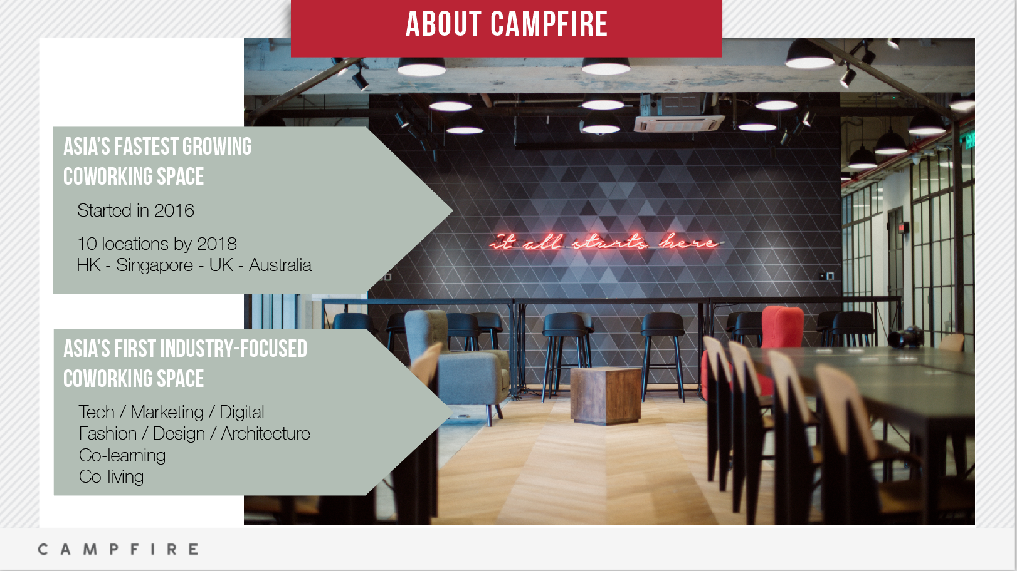
ABOUT CAMPFIRE

Slide 3


Slide 4





Kennedy Town
Private Offices
Fixed Desk
Event Space rental
HotDesk
Free PowerPoint Templates
Notes:
Campfire KT: Digital and tech environment focus.
We offer solution for:
every company/team size.
every industry
Need to target the need of your prospect. Listen to him/her and propose accordingly.

Slide 5
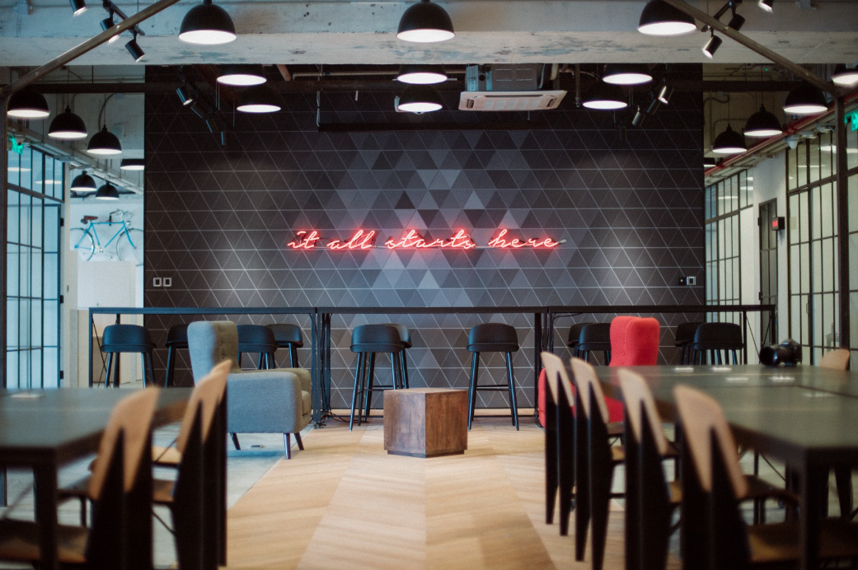


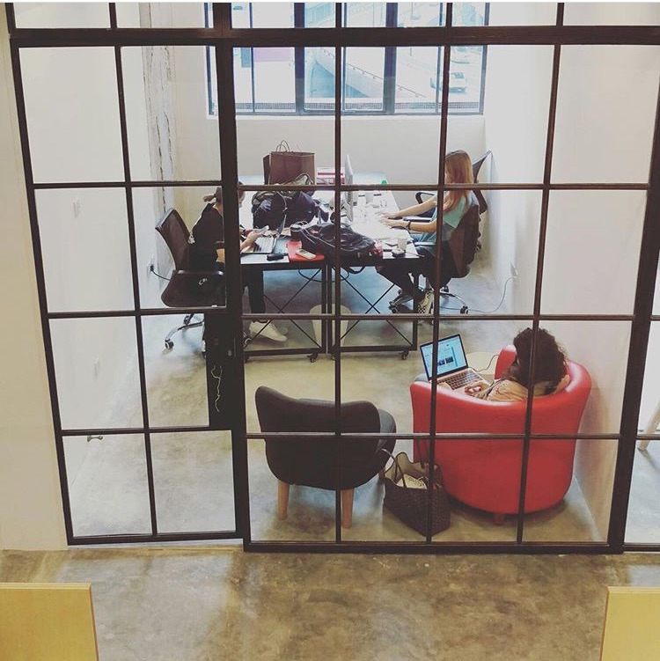

Wong Chuk Hang
Photo studio
Hot desk
Runway
Fixed Desk
Private Offices
Event Space rental
Free PowerPoint Templates
Notes:
Fashion, Design and Creative spirit.

Slide 6
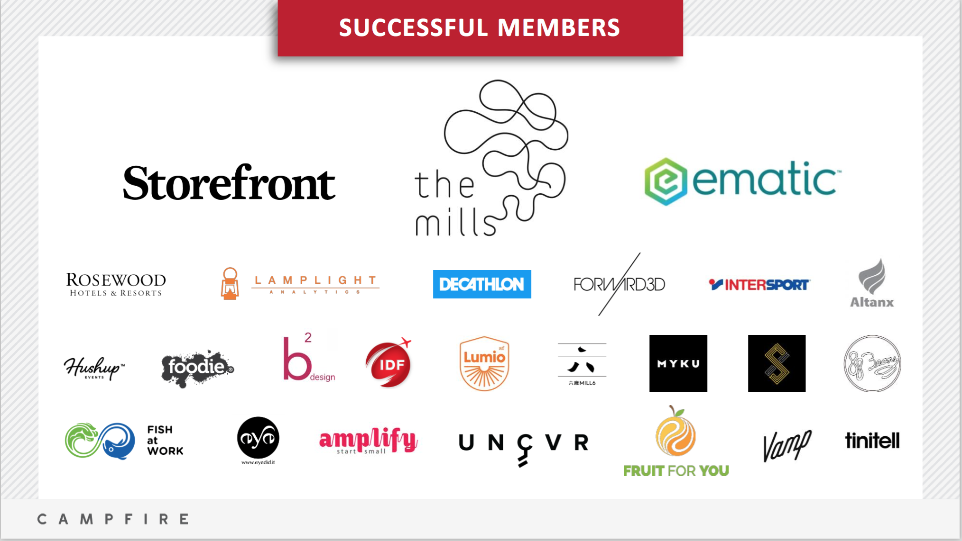

Slide 7
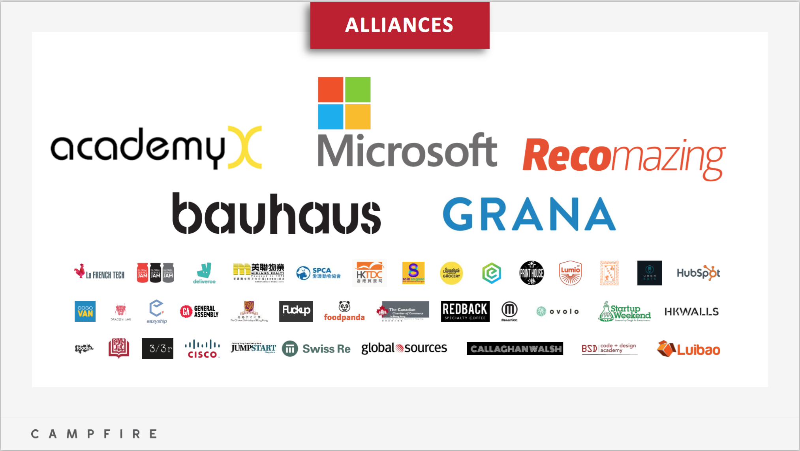

Slide 8
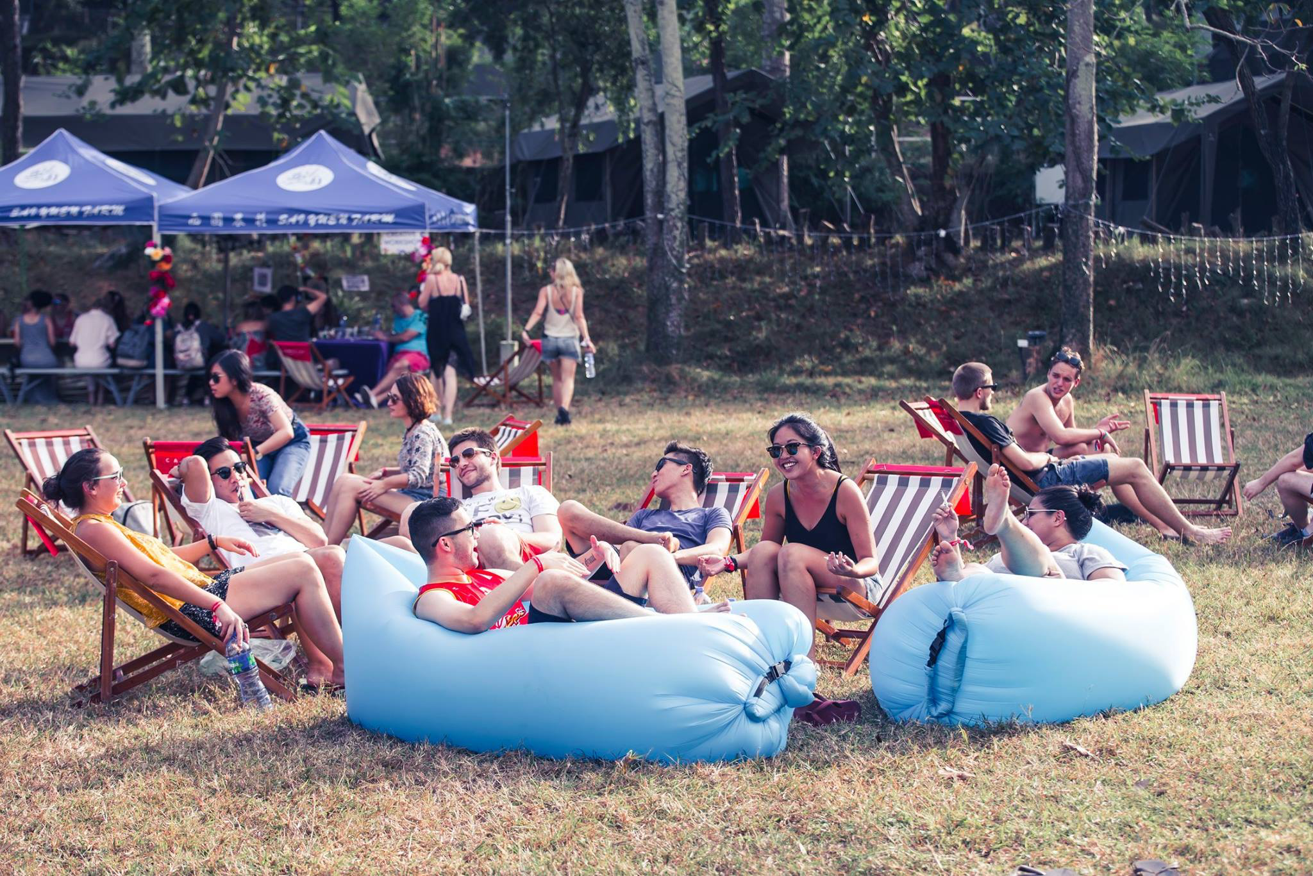
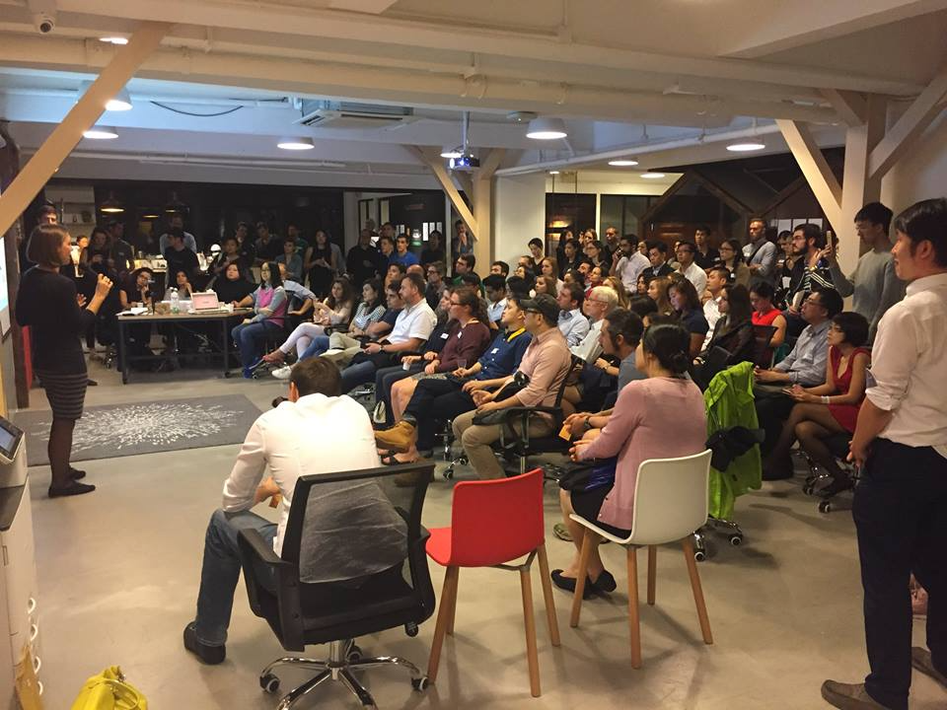
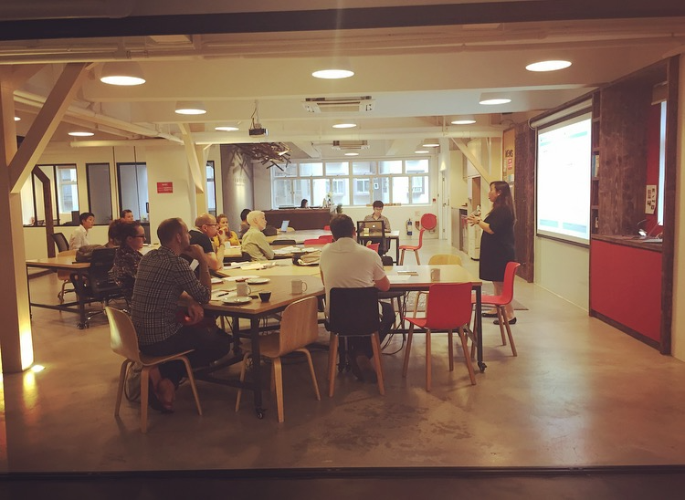
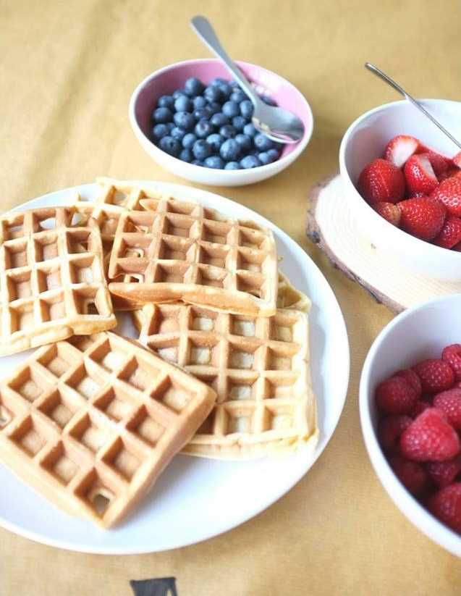

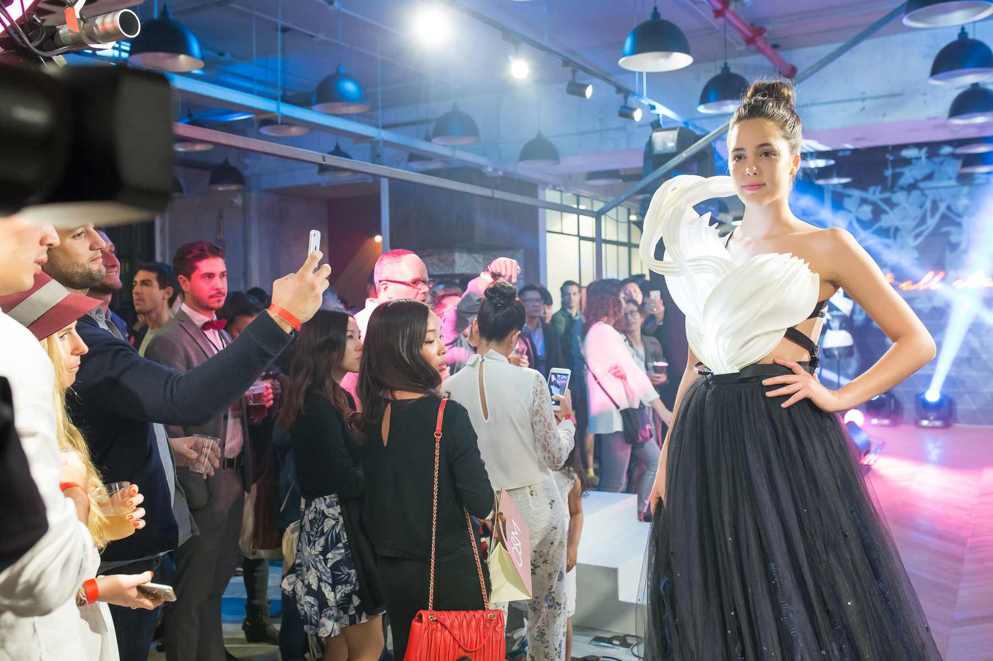
Campfire community events
Free PowerPoint Templates
Notes:
Campfire is planning to become the new ecosystem for (net)work.
Inspired work environment
Networking
Value added Service
Weekly events
-----------------------------------------------------
1) Campfire Secret Island Party – a two day outdoor event
2) Campfire Networking Thurdays – Pitch night event.
3) Campfire Waffle Wednesday – Monthly networking Breakfast event that are host by inspiring guest speakers.
4) Campfire WCH Grande Oppening – Fashion Show for showcasing HK’s talents in the fashion industries.
5) Campfire Yoga Classes – Bi-monthly classes

Slide 9
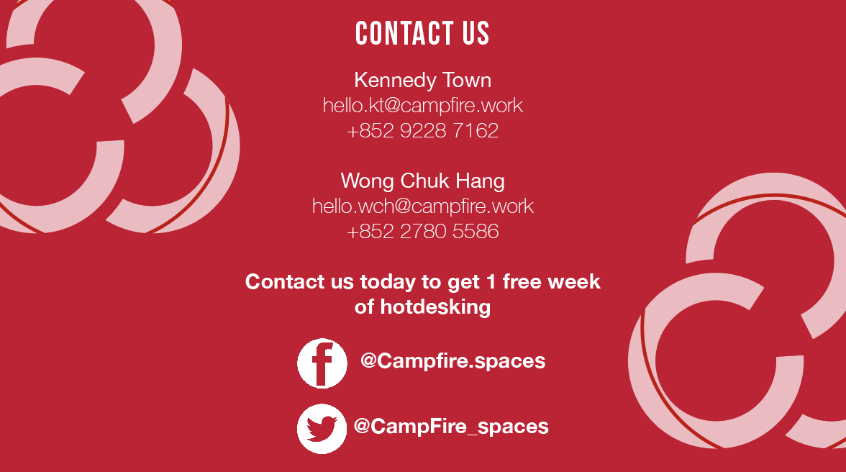
Contact us
Kennedy Town
k
+852 9228 7163

Slide 10
Machine Learning in eCommerce
Using Machine learning to increase conversions and sales
Reboot.ai

Slide 11
Agenda
Who: Who are we?
Why: Why value does machine learning add in eCommerce?
What: What algorithms are used in eCommerce?
Introduction to algorithms
Business Use Cases : User Personas, Product Recommendations
Which algorithm is used for this specific case?
How: How does this algorithm actually work?
High Level Description
Example Implementation
Q&A

Slide 12
About Reboot.ai
Who?
Matt O’Connor
BBA Finance
Previous: Lead Trader Algorithmic Desk - Macro Hedge Fund
Current: Full stack developer and professional Scrum Master (PSM I)
Avid futurist –social ramifications of AI & blockchain
Dhruv Sahi
BA Mathematics and Economics
Previous: Data Science Chief – Smart Cities Startup
Current: Business Intelligence Analyst – eCommerce - Grana
AI, IoT, and smart cities enthusiast
Reboot.ai
Hong Kong’s only dedicated machine learning and AI training provider
Part time evening courses for beginners and advanced
Curriculums developed in partnership with local data companies
Use ML & AI in our classrooms to improve teaching and personalize learning

Slide 13
Why Machine Learning?
Why?
1) Computers much faster than humans
Even complex or infinite solution problems have practical ‘solutions’ and optimizations
Ex. Google maps vs human intuition
2) Logic is replicable and scalable
Consistency of results not humanly possible
Conducive to experimentation and A/B testing can limit variables at play
3) Can incorporate elements of ‘learning’ from results
Can ‘teach itself’ and improve
Can identify insights that are not intuitive or sometimes invisible to humans

Slide 14
Headline Use Cases
Why?
Recommendation Engines: How Amazon and Netflix Are Winning the Personalization Battle and optimizing revenues
75% of all content on Netflix is viewed through their recommendation engine
35% of Amazon’s revenues are the product of their recommendation engine
Machine Learning Generates Clickbait Headlines That Will SHOCK You
Predict Sentiment From Movie Reviews Using Deep Learning
Can Chatbots Help Reduce Customer Service Costs by 30%?

Slide 15
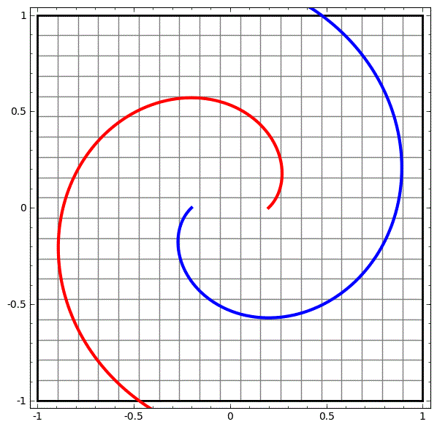
Separating Two Customer Groups…
Why?

Slide 16

…Is Easy for a machine
Why?

Slide 17
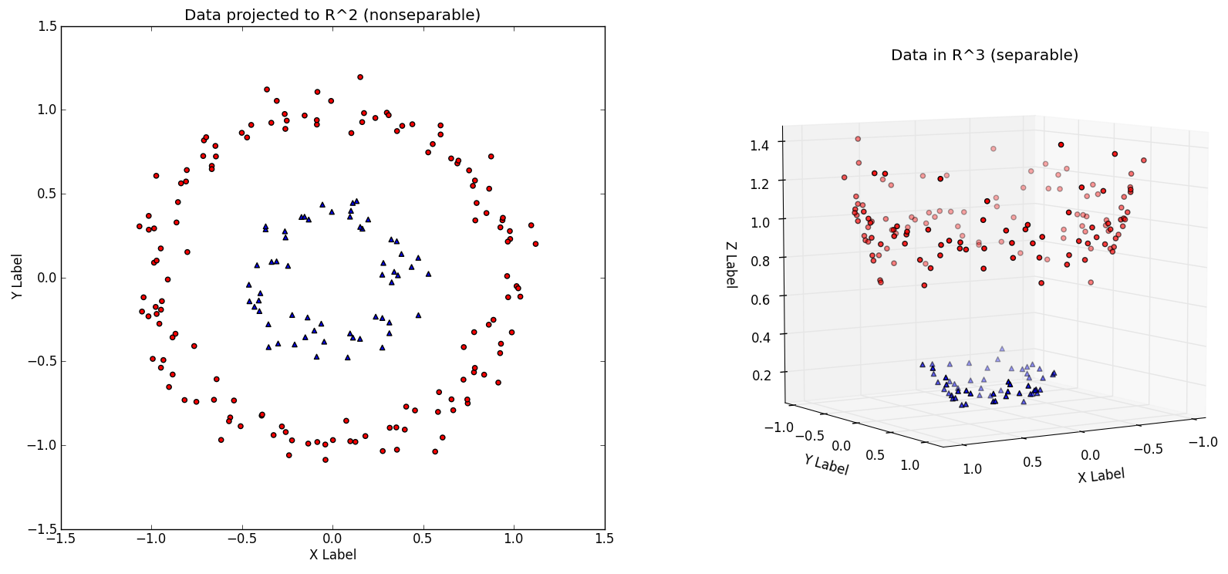
Multi Dimensional Reasoning
Why?

Slide 18
Summary: Why?
Why?
Benefits
Can be faster and cheaper than human alternative
Can be employed in a wide variety of real world conditions even with limited/flawed data
Can improve, learn, and identify trends humans would have trouble identifying
Weaknesses
Very difficult to create intelligence good in multiple unrelated contexts
No instincts, ‘genetic knowledge’ or ‘intuition’
Mistrusted and misunderstood
Questions?

Slide 19
What is an Algorithm
What?
An algorithm is a step by step process for completing a task.
Everyday examples: recipes, ‘habits’, traditions, traffic laws
Example in code
emailCustomer(gender):
if (gender == male):
sendPromoiton(shirt)
else
sendPromotion(dress)
Algorithm knows to suggest for gender, but not buying patterns, age, occasion, etc… is it intelligent?

Slide 20
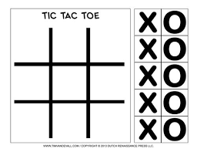
Tic-Tac-Toe Algorithm
What?
Let’s pseudo code an algorithm right now
If you were playing Tic-Tac-Toe, how would you decide to move?
Algorithm: a step by step process (game strategy) for completing a task (winning)

Slide 21
Tic-Tac-Toe Algorithm
What?
Check if we have 2 in a row next to an empty space, play and win
Check if opponent has 2 in a row next to an empty space, block it
Imagine playing in a space and how opponent would react… repeat
Try to play in spaces that maximize my connections while minimizing opponent’s
It’s just tic-tac-toe, it doesn’t matter that much, when in doubt choose randomly and remember what happens for next time (experiment)

Slide 22
Business Use Case #1: Segmenting Customers
What?
Customer Personas
‘a semi-fictional representation of your ideal customer based on market research and real data about your existing customers’
Allow for targeted marketing messages
Personalize = higher conversions
Previous method: manually identify, sort, and maintain separate lists
Problem: expensive (time and money), prone to human error, not standardized therefore not improvable

Slide 23
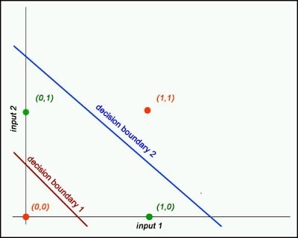
Segmenting Customer Personas
What?
Challenge: find a more repeatable, scalable process for sorting customers into distinct user personas
Type of problem: clustering (grouping)
Algorithm: K-means clustering
Why:
Groups data into distinct clusters
Doesn’t need to know any labels or additional information (unsupervised)
Can be used to label data for future categorization

Slide 24
K-Means Clustering: Details
How?
Goal: Group bunches of points into ‘K’ distinct groups
Provided Inputs
Set of Data Points
Integer value of ‘K’, ie 3 meaning split data points into 3 clusters
Outputs
K number of ranges containing all provided data points
Note this is not same as categorization (unsupervised)

Slide 25
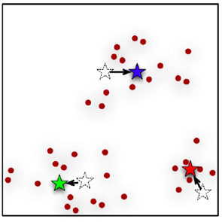
K-Means Clustering: Process
How?
1) Initialize K cluster points centers, called ‘centroids’ at random locations
2) For each point, calculate distance to centroids and assign to closest centroid (smallest distance)
3) Update centroid to average position of all data points in its cluster
4) Repeat steps 2 and 3 until clusters do not change from one run to next
5) Evaluate model: Silhouette Coefficient

Slide 26
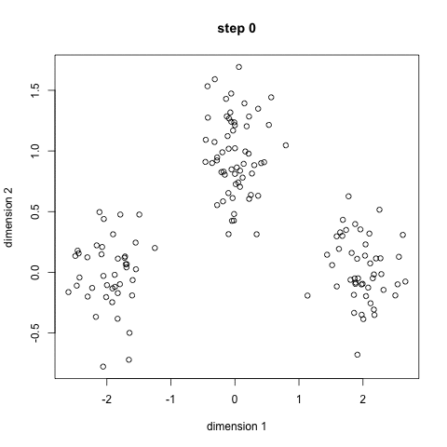
K-Means Clustering: Process
How?
Example of how clusters change per iteration
Here the random initial centroid spots create a ‘green’ cluster that is imprecise, and a ‘blue’ cluster spread between 2 clusters
As a result, the blue centroid is ‘pulled’ towards its center towards top middle, thus taking more out of green and shifting green to bottom left

Slide 27
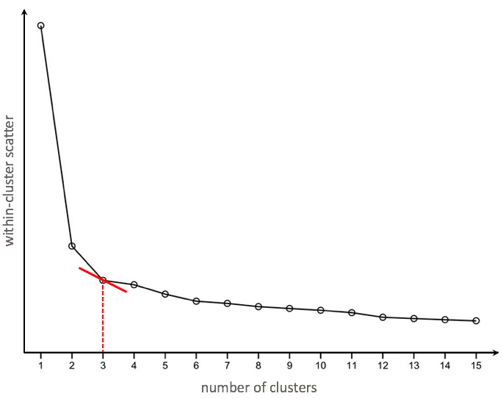
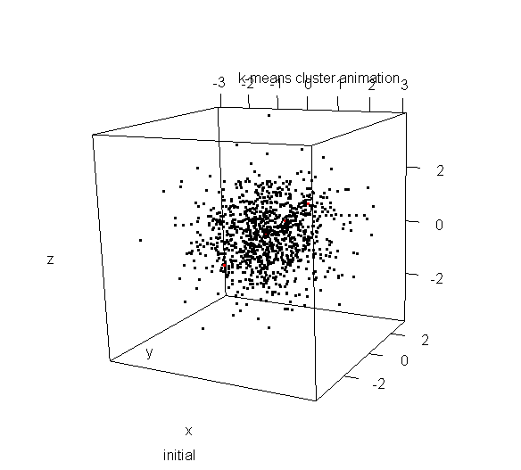
K-Means Clustering: Process
How?

Slide 28
Use Case #1- Clustering Personas Summary
High Level
Separating user personas is a situation with a lot of unlabeled data
KMeans clustering can be used to group data points into K distinct groups
Advantage is that is relatively easy to implement
Deeper Dive
An iterative algorithm which runs many times
Optimizes centroids at the average point of all the points within their cluster
Questions?

Slide 29
Business Use Case #2: Product Recommendations
What?
Product Recommendations
Allow for personalized advertising, complementary buys, and upsells
Maximize each customer’s lifetime value
Previous method: one-size-fits-all recommendations
Problem: not personalized, can be operationally difficult

Slide 30
Product Recommendations
What?
Challenge: generate personalized recommendations for each individual user, not just broad categories of users
Type of problem: neighbor distance calculation
Algorithm: K-Nearest Neighbors (KNN)
Why:
Calculates nearest neighbors to any given data point
Relatively simple to implement with high output quality
Can incorporate various sources of data: product characteristics or characteristics of users who also bought, special logic (context)

Slide 31
KNN: Details
How?
Goal: Find the most similar items to a given data point by mapping out the entire universe of relevant points
Provided Inputs
Specific data point
Universe of data points
K – number of neighbors to return
Method to calculate similarity
Outputs
K neighbors closest (most similar) to provided input data point

Slide 32
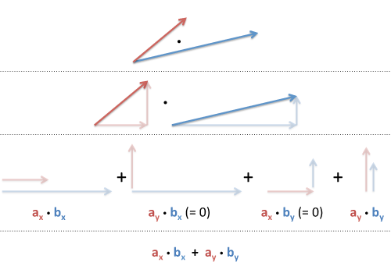
KNN Cosine Similarity: Side Note
How?
Side note: Why cosine similarity?
We must first answer, what are vectors?
Distance between two points is a function of two elements:
Magnitude
Direction
Vectors are combinations of magnitudes and direction, and multi-dimensional vectors can be broken down into smaller parts (ie x and y)
Allows us to create a single vector which expresses multiple different metrics, such as 1) user rating and 2) price

Slide 33
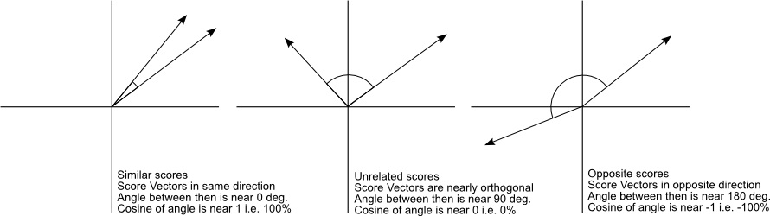
KNN Cosine Similarity: Side Note
How?
Side note: Why cosine similarity?
Multiple ways of measuring similarity between two items
Pure distance between two things isn’t always best measure
Consider case of direction as positive or negative ratings
End distance from points not as important as similarity in vectors

Slide 34
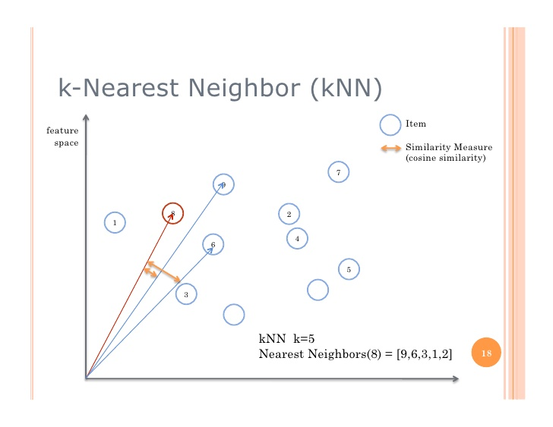
KNN Cosine Similarity: Process
How?
1) Clean, wrangle and normalize your data
2) Pick a point from data set and calculate distance (cosine similarity) from given point
3) Repeat for all points in data set
4) Return K choices with highest similarities

Slide 35
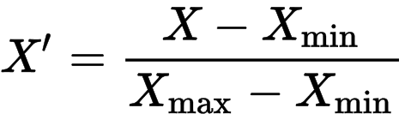
KNN Cosine Similarity: Process
How?
1) Prepare inputs
Select columns: style_attributes & mrp
Clean data and convert into correct numerical types
Normalise data using the feature scaling and ordinal scaling techniques
Store inputs in correct data structure, i.e. dictionary in this case
2) Define a function to calculate distance between any two points
3) Write function to iterate distances between primary point to find it’s closest K neighbors
4) Return neighbors as suggestions
Let’s look at the code!

Slide 36
Use Case #2- Product Recommendations
High Level
Using datasets in different segments to make more personalized recommendations to customers
Increase basket size and average order value to drive sales and improve customer experience
Advantage: automate reccommendations to customers on the website/eDM/ads
Deeper Dive
A non-parametric, lazy algorithm that returns closest matches given a starting point and number of desired recommendations
Uses some type of distance metric to compute distance, and returns closest neighbors
Questions?

Slide 37
Practical Tips and Tools For ML & AI in eCommerce
NLP – it’s complex under the hood, but easy to implement
Sentiment analysis for reviews: https://www.lexalytics.com/
Chatbot platform with lots of easy integrations: API.ai
Python – many powerful libraries to start analyzing your data today
Scikit-learn, SciPy, StatsModels, PySpark, NLTK and many others
Cloud services for running recommendation engines in real-time
Enterprise Cloud Solutions for Deployment (e.g. AWS EMR + Redshift + Elastic Beanstalk)

Slide 38
Matt R O’Connor http://Reboot.ai 6289.9447 matt.oconnor217@gmail.com linkedin.com/in/mattroconnor/
Dhruv Sahi
http://Reboot.ai 5572 8474 dhruvsahi@gmail.com
linkedin.com/in/dhruv-sahi/

Slide 39
Resources
http://bigdata-madesimple.com/possibly-the-simplest-way-to-explain-k-means-algorithm/
https://www.ncbi.nlm.nih.gov/pmc/articles/PMC4978658/
https://saravananthirumuruganathan.wordpress.com/2010/05/17/a-detailed-introduction-to-k-nearest-neighbor-knn-algorithm/
https://www.youtube.com/watch?v=C-JauEnlSlM

